Slide 1

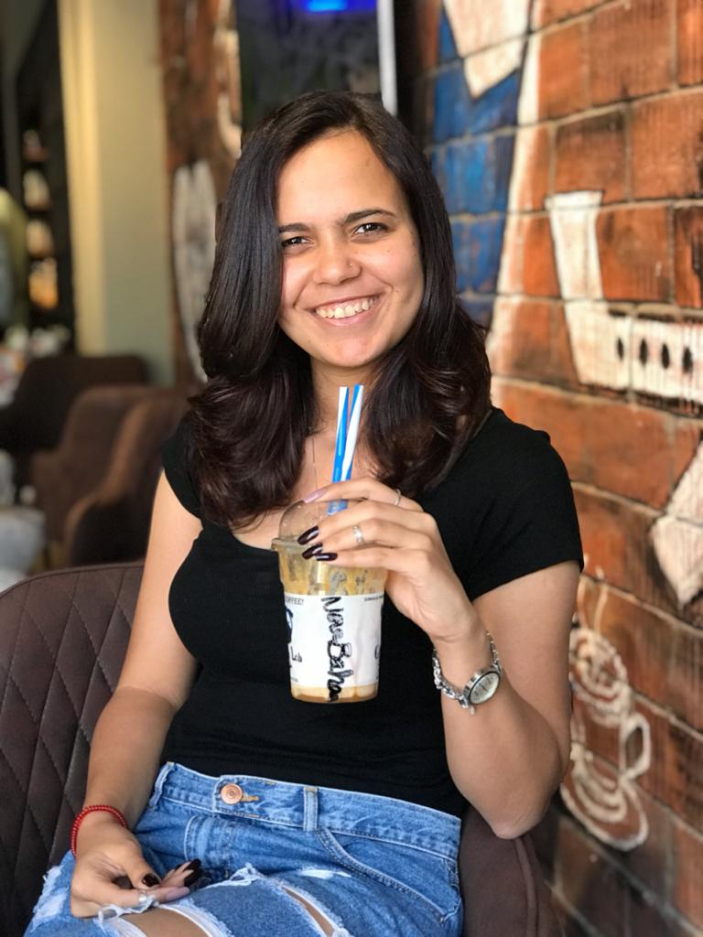
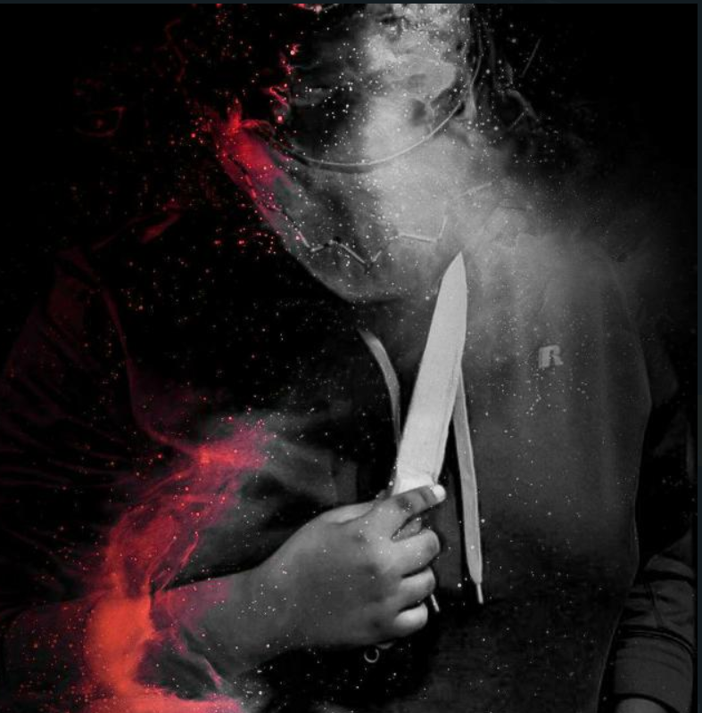
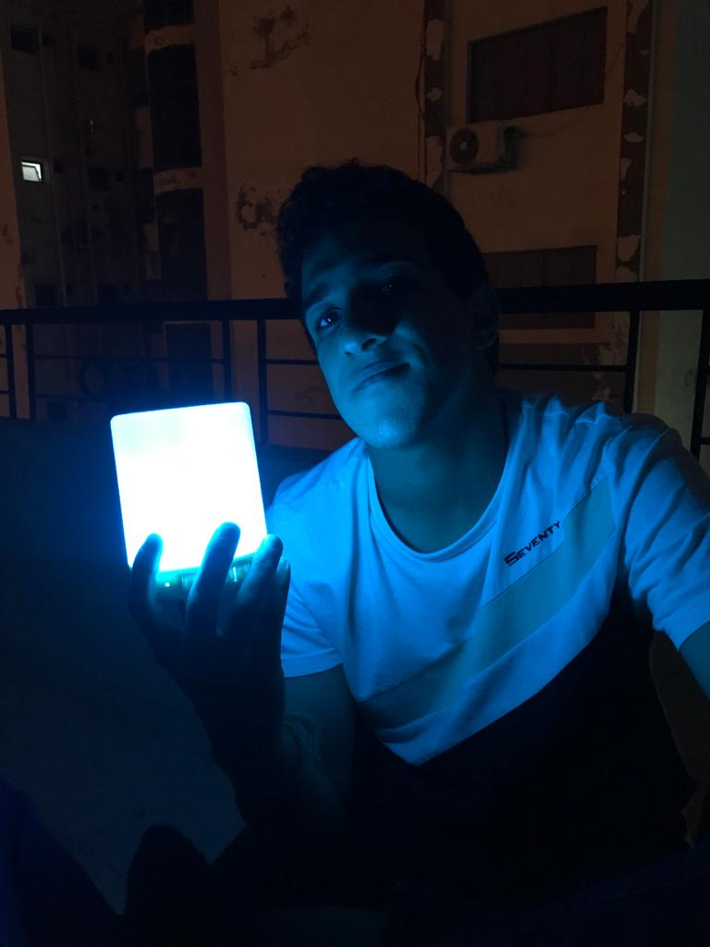
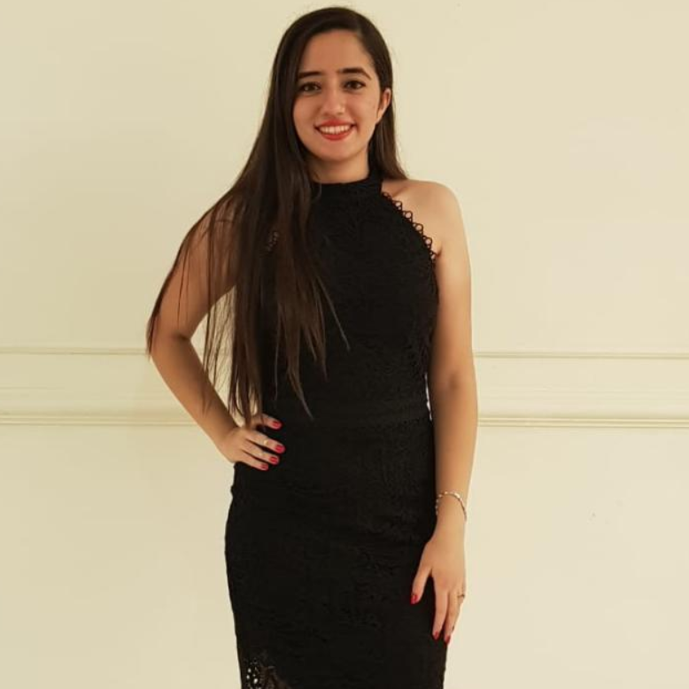
Wild Oat Detection
Presented By:
* Abanoub George
* Mai Mahmoud
* Ibrahim Fawzy
* Nour Bahaa
Supervised By:
* Prof. Khalid Hussein
* Eng. Hager Sobeah
* Eng. Nour El-Huda Ashraf

Slide 2
Agenda.
Introduction.
Problem Background.
Existence Solution.
Our Challenge.
Our Solution.
Related Work(1/2).
Related Work(2/2).
Possible Solutions.
System Overview.
Expected Results.
Demo

Slide 3

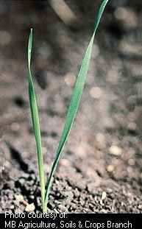
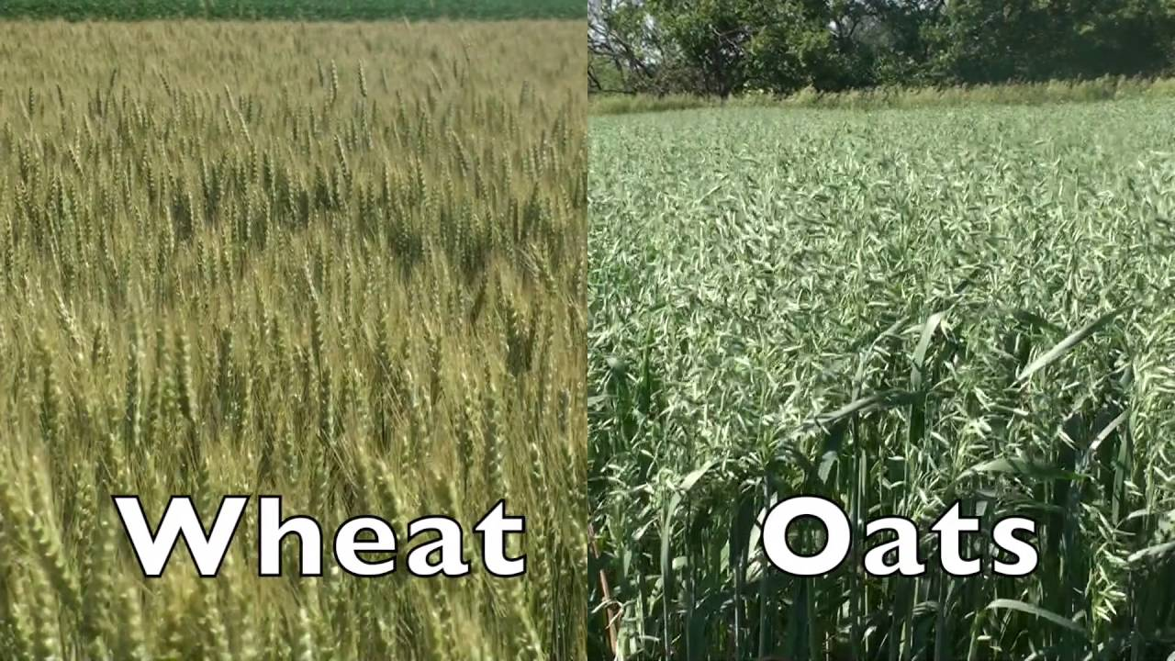
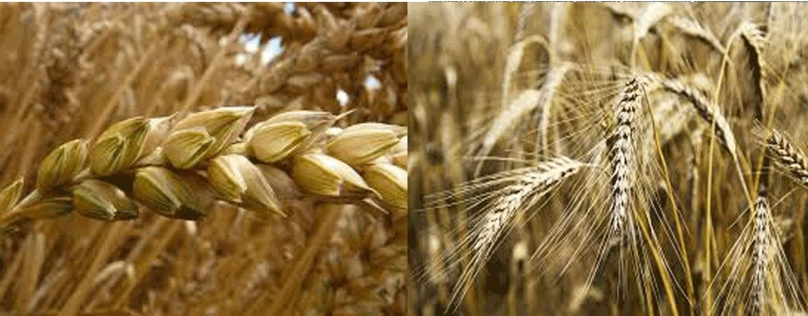
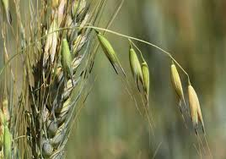
Introduction.
Data Collecting
Image Processing
Deep Learning
What’s Wild Oat?
If spread what happens ?
1
Problem Background.
2
Existence Solution.
3
Our Challenges.
4
Our Solution.
93%
3/4
15 cm
100 to 150
Chemicals
Remove by Hand
Winter Plant
Lie Agriculture irrigation
What are their disadvantages ?

Slide 4
Related Work(1/2).
Detection of Weed and Wheat using image processing
Stages
Dataset
Results
UAV
Green
Yellow
15,000 image
Image Processing using CNN
[1] S. Hameed and I. Amin, "Detection of Weed and Wheat Using Image Processing," 2018 IEEE 5th International Conference on Engineering Technologies and Applied Sciences (ICETAS), Bangkok, Thailand, 2018, pp. 1-5, doi: 10.1109/ICETAS.2018.8629137.

Slide 5
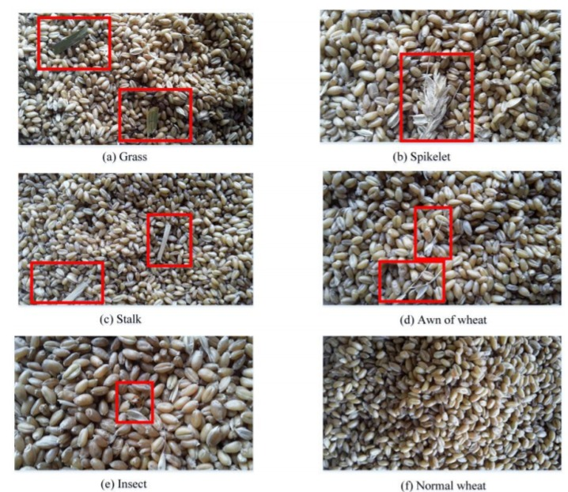
Related Work(2/2).
Image Recognition Method Based on an Improved Convolutional Neural Network to Detect Impurities in Wheat
Problem
Dataset
Results
Wheat
Insect
Grass
Stalk
Spikelet
Awn
25,200 – 10,800
98.59% and 99.98%
[1] Y. Shen et al., "Image Recognition Method Based on an Improved Convolutional Neural Network to Detect Impurities in Wheat," in IEEE Access, vol. 7, pp. 162206-162218, 2019, doi: 10.1109/ACCESS.2019.2946589.

Slide 6
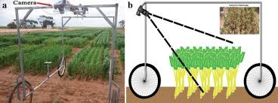
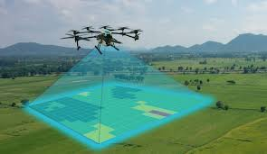
Possible Solutions.

Slide 7
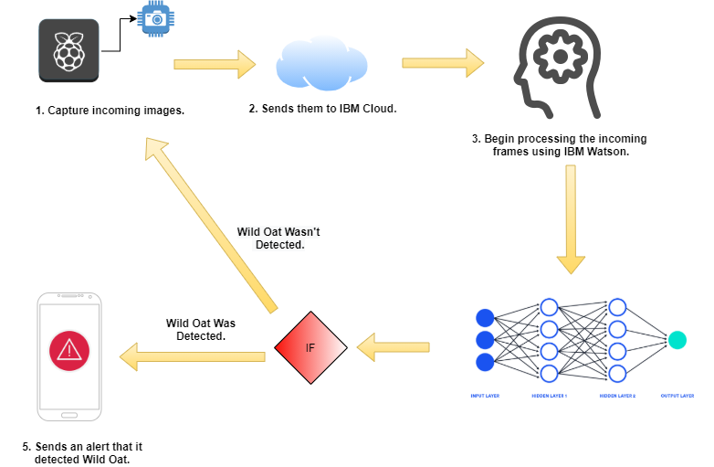
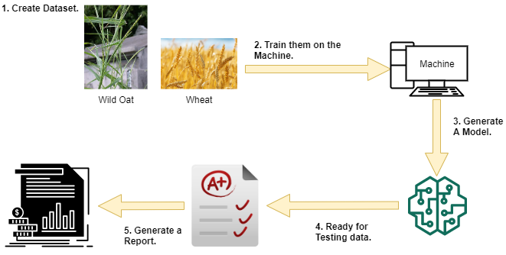
System Overview.
Model Creation.
System Overflow.
Then
Notes:
Model Creation:
At the beginning we started by a dataset that is going to be trained on a machine to generate a model. When the model is fed enough, it’s going to be ready for the evaluation phase and to generate stats and analysis.
System Overflow:
After our model becomes ready now we have to put it on a Raspberry Pi which is attached to a camera module. So our device will be ready to record videos of the field and sends them to the cloud for processing. Then the NN will start to detect the wild oat.

Slide 8
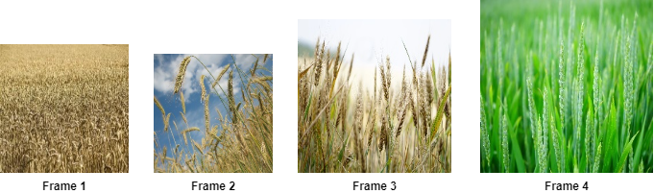
System Overview – Dataset.
Our Dataset is divided into two main classes the Wheat class and the Wild Oat class and it consists of non normalized data of type images .
We didn’t find a dataset
Agriculture Research Center Laboratory in Giza Government , in Cairo to collect it from them after a month
Notes:
Dataset:
Our dataset, which is considered a challenge for us consists of 2 main classes wheat and wild oat which are non normalized images.
We already have a dataset for wheat but for wild oat we don’t have so one of our contributions is that we are going to build a dataset for the wild oat.

Slide 9


System Overview -- Input.
Our input will be through incoming frames from the camera module to the IBM Cloud data service.
Notes:
Input:
Our input will be through incoming frames from the camera module to the IBM Cloud data service.

Slide 10
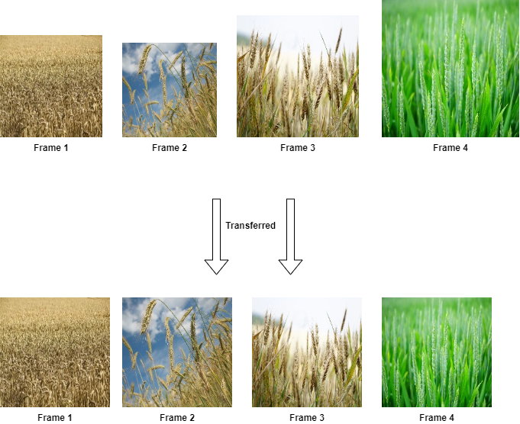
System Overview -- Pre-Processing.
Normalized data makes Neural Network works better. So, in the pre-processing stage our model must normalize the incoming frames by giving them same target size for all the images and divide them into batches.
[1] V. Sathya Durga and T. Jeyaprakash, "An Effective Data Normalization Strategy for Academic Datasets using Log Values," 2019 International Conference on Communication and Electronics Systems (ICCES), Coimbatore, India, 2019, pp. 610-612, doi: 10.1109/ICCES45898.2019.9002089.
Notes:
Pre-Processing:
According to the paper “An Effective Data Normalization Strategy for Academic Datasets using Log Values," , it summarizes how normalized data will make the NN works better than with normal data.

Slide 11
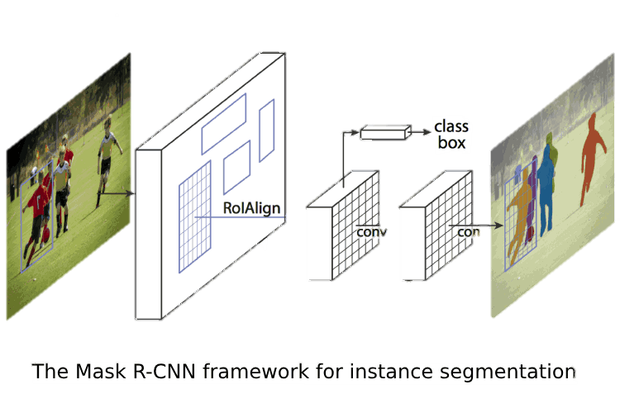
System Overview -- Main Processing.
The main processing phase is where we train our model with the dataset images so it can detect our incoming frames using TensorFlow and Keras python libraries to use the Mask R-CNN for detection phase.
[1] K. He, G. Gkioxari, P. Dollár and R. Girshick, "Mask R-CNN," 2017 IEEE International Conference on Computer Vision (ICCV), Venice, 2017, pp. 2980-2988, doi: 10.1109/ICCV.2017.322.
Notes:
Main Processing:
In the main processing phase is where we train our model with the dataset images so it can detect our incoming frames using TensorFlow and Keras python libraries to use the Mask R-CNN for detection phase.

Slide 12
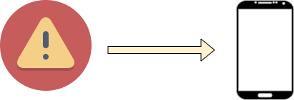
System Overview -- Output.
The output of our system will end in one of the two ways either,
Our system doesn't detect a wild oat and continue capturing videos of the field.
Our system detects a wild oat, then it will send a notification to the mobile app that their is a wild oat and the buzzer, which is connected to the Raspberry Pi will rings.
Notes:
Output:
The output of our system will end in one of the two ways either,
Our system doesn't detect a wild oat and continue capturing videos of the filed.
Our system detects a wild oat, then it will send a notification to the mobile app that their is a wild oat and the buzzer, which is connected to the Raspberry Pi will rings to tell him that there is a wild oat here and he should remove it.

Slide 13
Expected Results.
Recognition.
Our model will be trained to classify between the wild oat from the wheat in the early stage.
Early Detection & Classification.
Our system shall use real-time recorded detection.

Slide 14
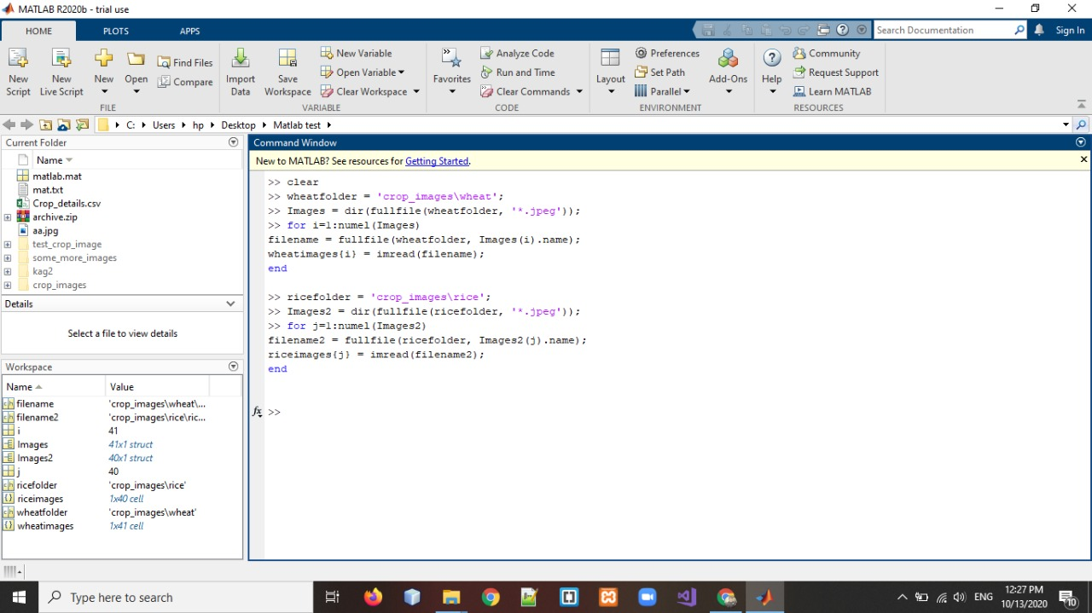
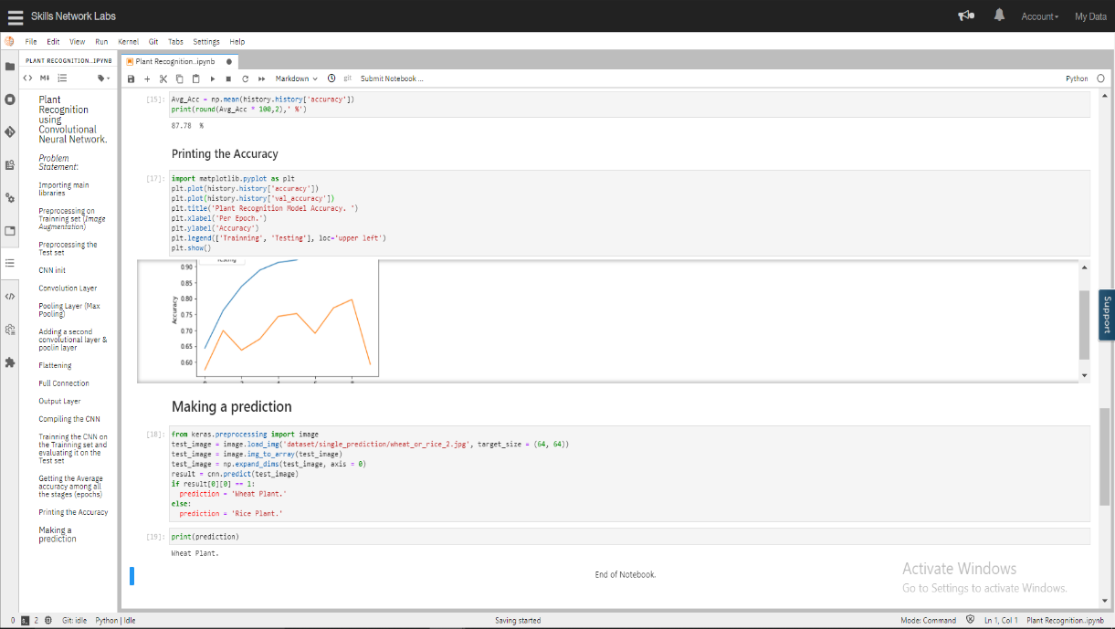
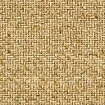
Demo
MATLAB Demo.
Python Demo.

Slide 15


